Slide 1
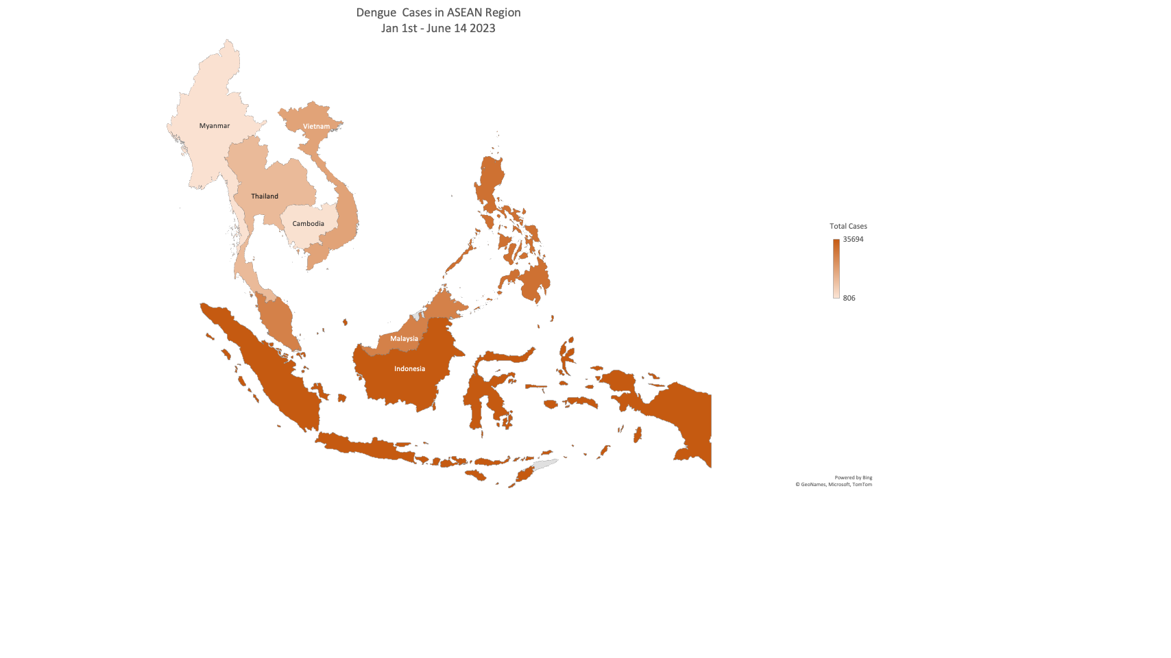
Philippines
Brunei
Darussalam
Malaysia

